Slide 1
Chinese Comparison Project
Period 9

Slide 2
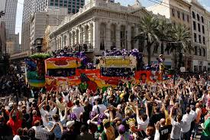
New Orleans Madi Gra Festival
The Madi Gra Festival Was Tuesday, February 17 It Is A Huge Festival that happens every year and it latest about 2 weeks long. Madi Grs is where hundreds of people listen to new Orleans music and dance get drunk party wear bead and have fun in the new Orleans atmosphere with
great food around you and happy people. Many nationalities from all over come to celebrate this festival.

Slide 3
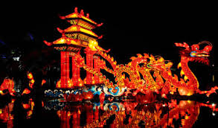
Chinese Festival
HAIS Celebrated The Chinese festival every Chinese class period performed a song and danced and we als o had food and different Chinese snacks to buy for $ 1. I saw the different types of Chinese dances.

Slide 4
Similarities
The Similarity in both events was people enjoyed the food and activities and in both events people learn more about the culture around them.

Slide 5
Differences
The differences in the events is culture,food,dress attire , and the events happening in the festivals.

Slide 6
Conclusion
Both festivals are full with food and game activities culture and many other aspects. People enjoy the festivals every year and I think it is important for these two festival's to continue informing people of there great culture.

